Slide 1
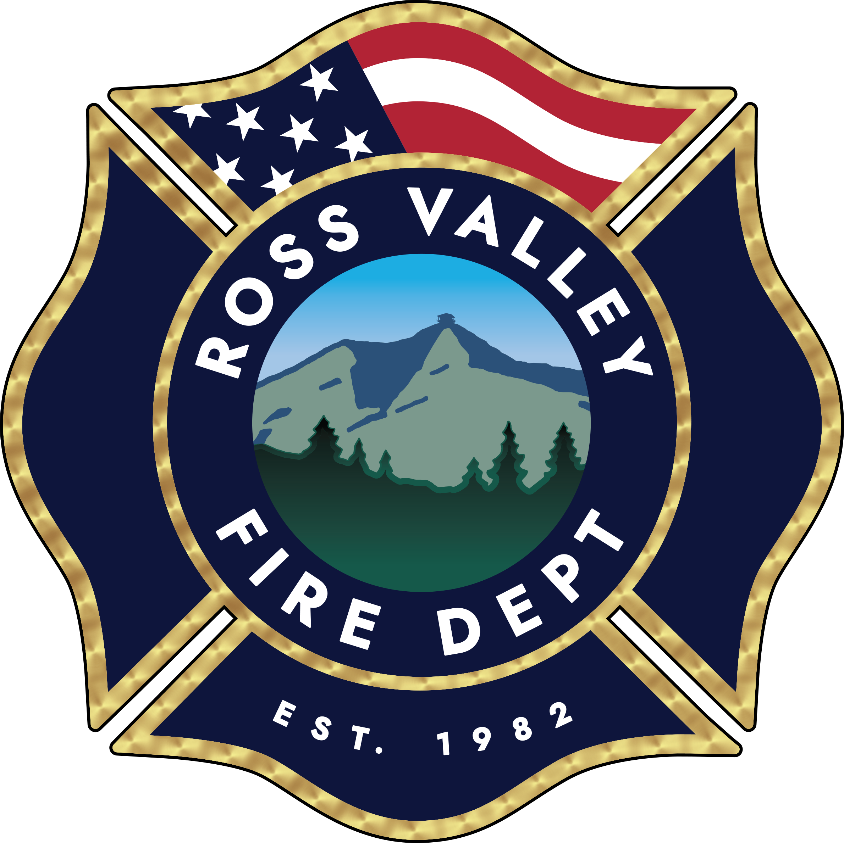
Ross Valley Fire Department
Defensible Space/ Vegetation Management in the Ross Valley
Presented by:
Nicole Marcucci
Wildfire Preparedness Coordinator

Slide 2
Ross Valley Fire Department
Properties Inspected | 2,493 (70 did not receive a reinspection)
Re-Inspections Completed | 2,338
Total Inspections | 4,901
Engagement within 15 days | 2,489 (50.77%)

Slide 3

10 Most Common
Defensible Space Items
Hazard | Number of Recorded Issues/Violations
Vegetation in Zone 0 | 2,279
Ladder Fuels | 813
Tree Limbs Overhang Structure | 672
Tree Requires Limbing | 326
Combustible Growth Near Roadway | 279
Patio Furniture Cushions | 373
Combustible Doormats | 359
Leaf or Needle Litter on Ground | 429
Grasses and Weeds | 283
Rosemary | 355

Slide 4
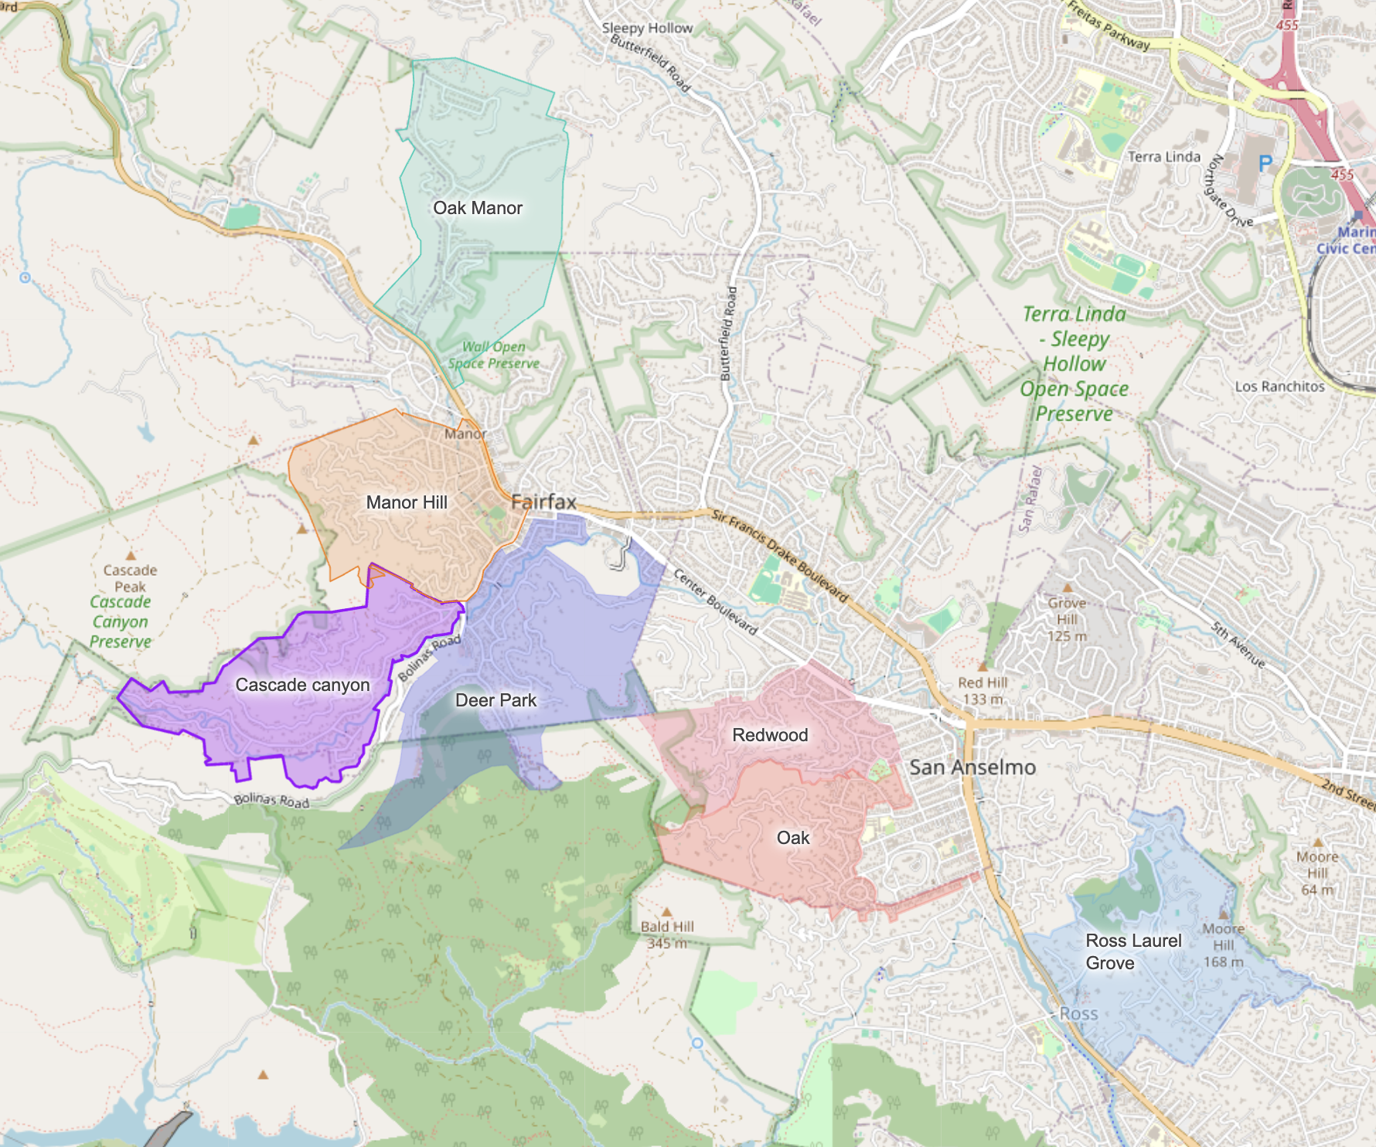
Inspection Zones

Slide 5

Town of Fairfax
Properties Inspected | 1,652 (47 did not receive a reinspection)
Re-Inspections Completed | 1,563
Total Inspections | 3,262
Report Open Rate | 1,694 (51.90%)

Slide 6
10 Most Common
Defensible Space Items
Hazard | Number of Recorded Issues/Violations
Vegetation in Zone 0 | 1,439
Ladder Fuels | 487
Tree Limbs Overhang Structure | 439
Tree Requires Limbing | 200
Patio Furniture Cushions | 250
Combustible Doormats | 205
Other Combustibles Near Structure | 186
Leaf or Needle Litter on Ground | 311
Grasses and Weeds | 237
Rosemary | 232

Slide 7

Town of Ross
Properties Inspected | 186 (18 did not receive a reinspection)
Re-Inspections Completed | 168
Total Inspections | 360
Report Open Rate | 163 (45.10%)

Slide 8
10 Most Common
Defensible Space Items
Hazard | Number of Recorded Issues/Violations
Vegetation in Zone 0 | 225
Ladder Fuels | 114
Tree Limbs Overhang Structure | 58
Tree Requires Limbing | 44
Combustible Growth Near Roadway | 41
Combustible Doormats | 29
Patio Furniture Cushions | 27
Combustible Mulch | 26
Rosemary | 31
Broom Plants | 27

Slide 9

Town of San Anselmo
Properties Inspected | 650 (17 did not receive a reinspection)
Re-Inspections Completed | 607
Total Inspections | 1,274
Report Open Rate | 627 (49.22%)

Slide 10
10 Most Common
Defensible Space Items
Hazard | Number of Recorded Issues/Violations
Vegetation in Zone 0 | 609
Ladder Fuels | 210
Tree Limbs Overhang Structure | 173
Combustible Growth Near Roadway | 88
Tree Requires Limbing | 81
Combustible Doormats | 125
Patio Furniture Cushions | 95
Combustible Mulch | 70
Leaf or Needle Litter on Ground | 91
Rosemary | 90

Slide 11
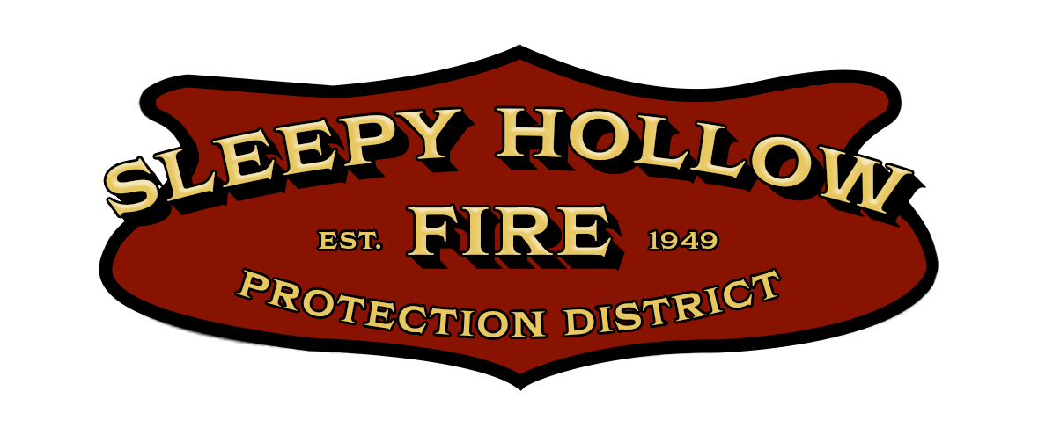
Sleepy Hollow Fire Protection District
Sleepy Hollow is on a bi-annual inspection rotation. They did not receive any inspections this year but will receive them next year.
Inspection Schedule
No inspections conducted this year — district resources were focused on the Direct Assistance Program targeting Zone 0 vegetation removal
The entire district will be inspected next year
Direct Assistance Program Overview
Launched in 2022 by the Sleepy Hollow Fire Protection District
Provides free hazardous vegetation removal and disposal using a local, licensed contractor
Initially focused on removing hazardous species such as:
Bamboo
Juniper
Italian cypress
Dead trees
Program impact since inception:
Over 100 residents have received assistance
2025 Program Focus
Shifted focus to Zone 0 vegetation removal and vent screening upgrades
Added support for additional preparedness improvements
Over a dozen homes assisted this year in preparing for wildfire resilience

Slide 12
Wildfire Preparedness Projects
Evacuation/Roadside Clearance
Voluntary Abatement
Larger Fuel Modification Projects

Slide 13
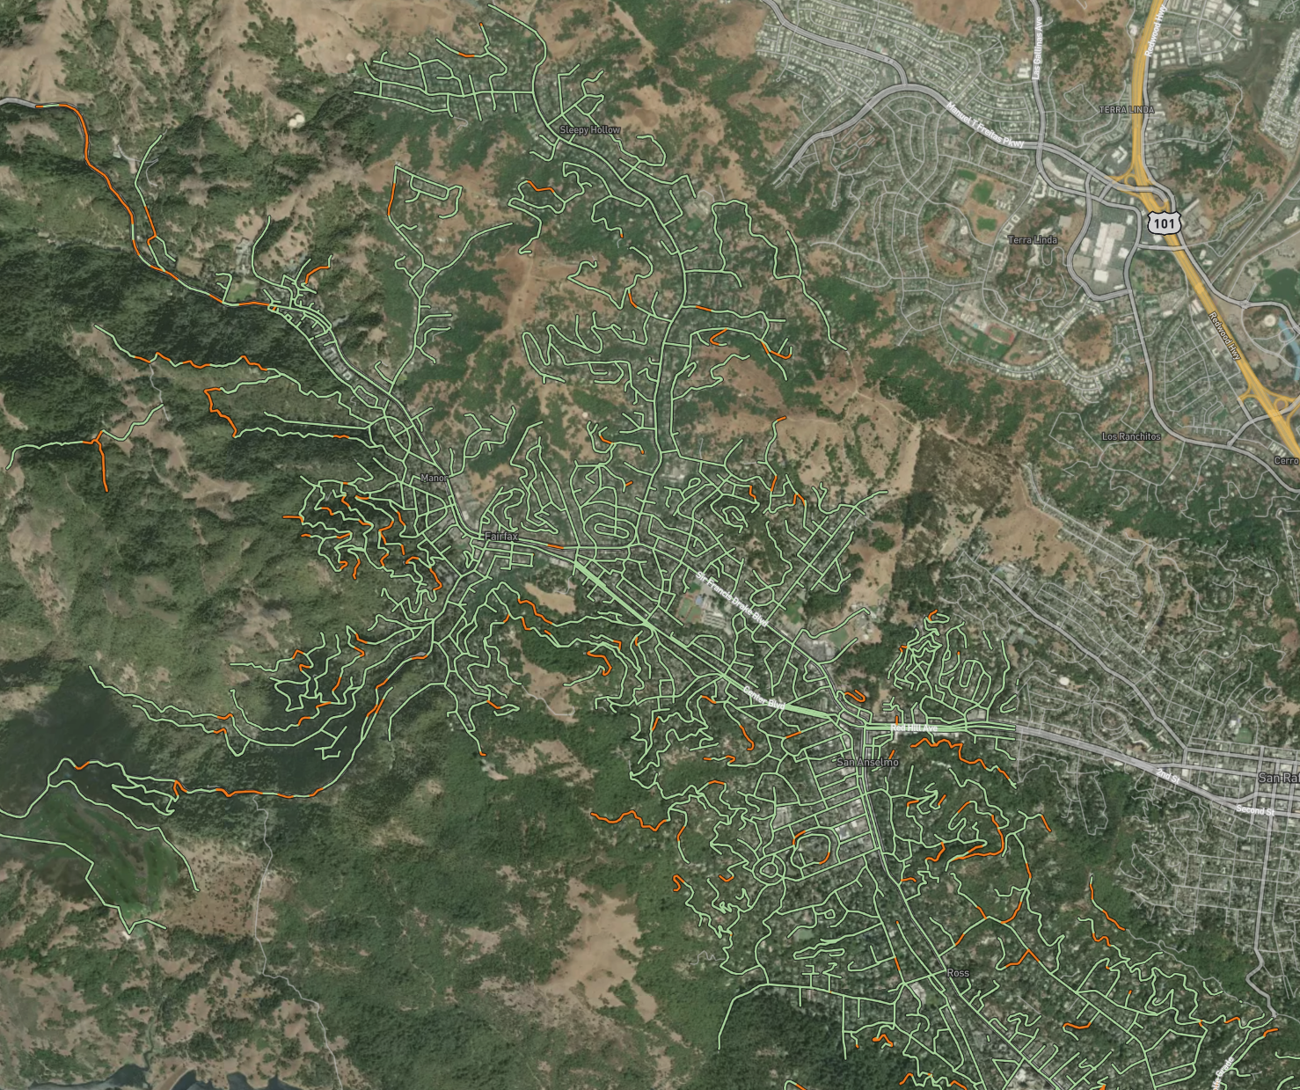
Tools to decide
prioritization/location of projects
Wildfire Resilient Roads Maps
Genasys (formerly known as Zonehaven)
Fire Aside
GIS
Local Hazard Mitigation Plan
Field Observations
Intra-Agency Relationships
Wildfire Resilient Road Maps

Slide 14
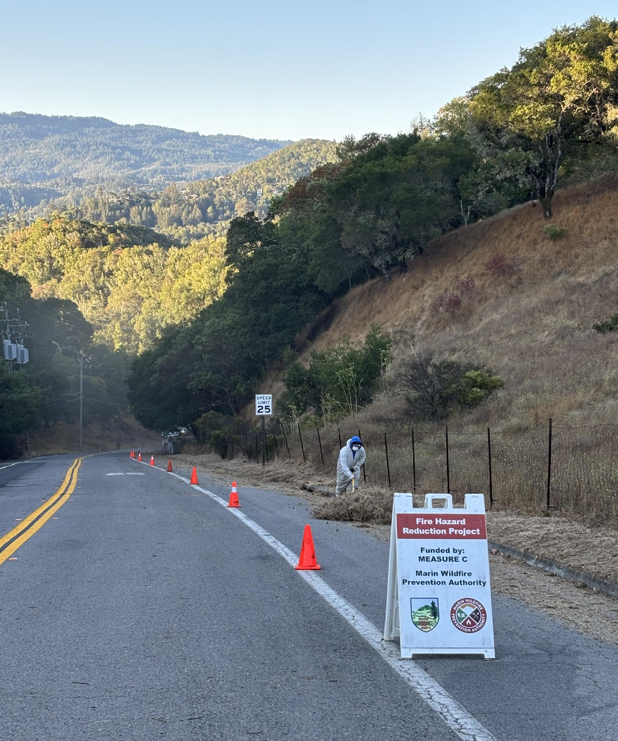
Evacuation Road Clearance
Improve safety and accessibility through evacuation clearance of public roads.
Benefits:
Increases safety during evacuations.
Improves visibility for daily traffic.
Potentially decreases emergency response times.
Scope of Work:
Clear vegetation 10 feet from the edge of the paved road.
Remove 15 feet of overhanging vegetation.
Resident Communication:
Residents are notified by U.S. Mail before work begins.
Invitation for residents to engage with the department and participate.
Additional Outcomes:
Allows access to overgrown drainages and areas beyond the 10-foot clearance zone.
Enhances road resilience and reduces fuel load for fire prevention.

Slide 15
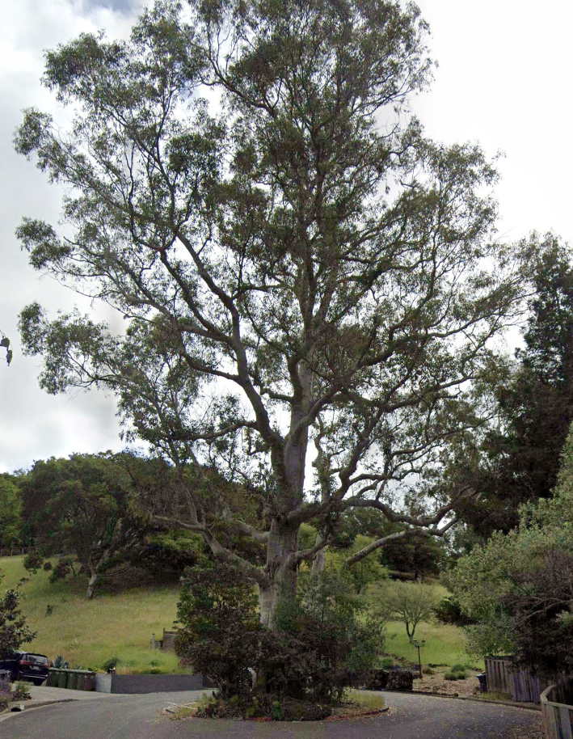
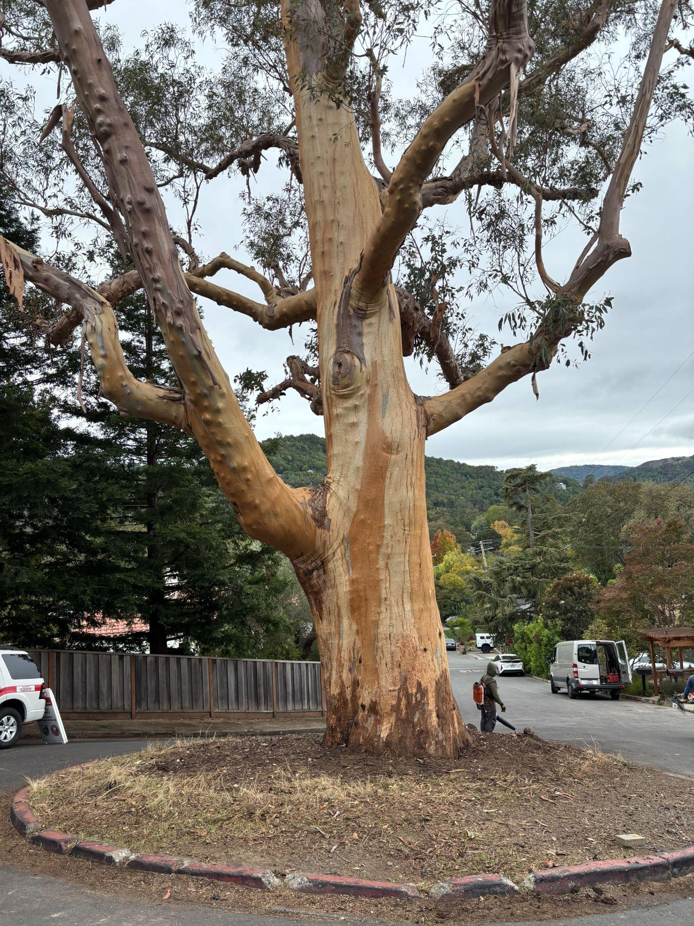
Voluntary Abatement
After
Before
Voluntary abatement is an optional program for residents to help reduce fuel loads on private properties.
Goals & Benefits:
Lowers fuel loads to improve fire safety.
Assists elderly and low-income residents who may not afford or complete vegetation work.
Removes initial vegetation work costs for participants.
Enhances overall neighborhood safety.
Property Selection:
Determined using multiple data sources to strategically target properties for fuel modification.
Priority given to residents unable to afford or perform the work themselves (typically elderly or low-income).
Program Integration:
Offered to residents with large parcels or drainages, often coordinated with roadside clearance projects.

Slide 16
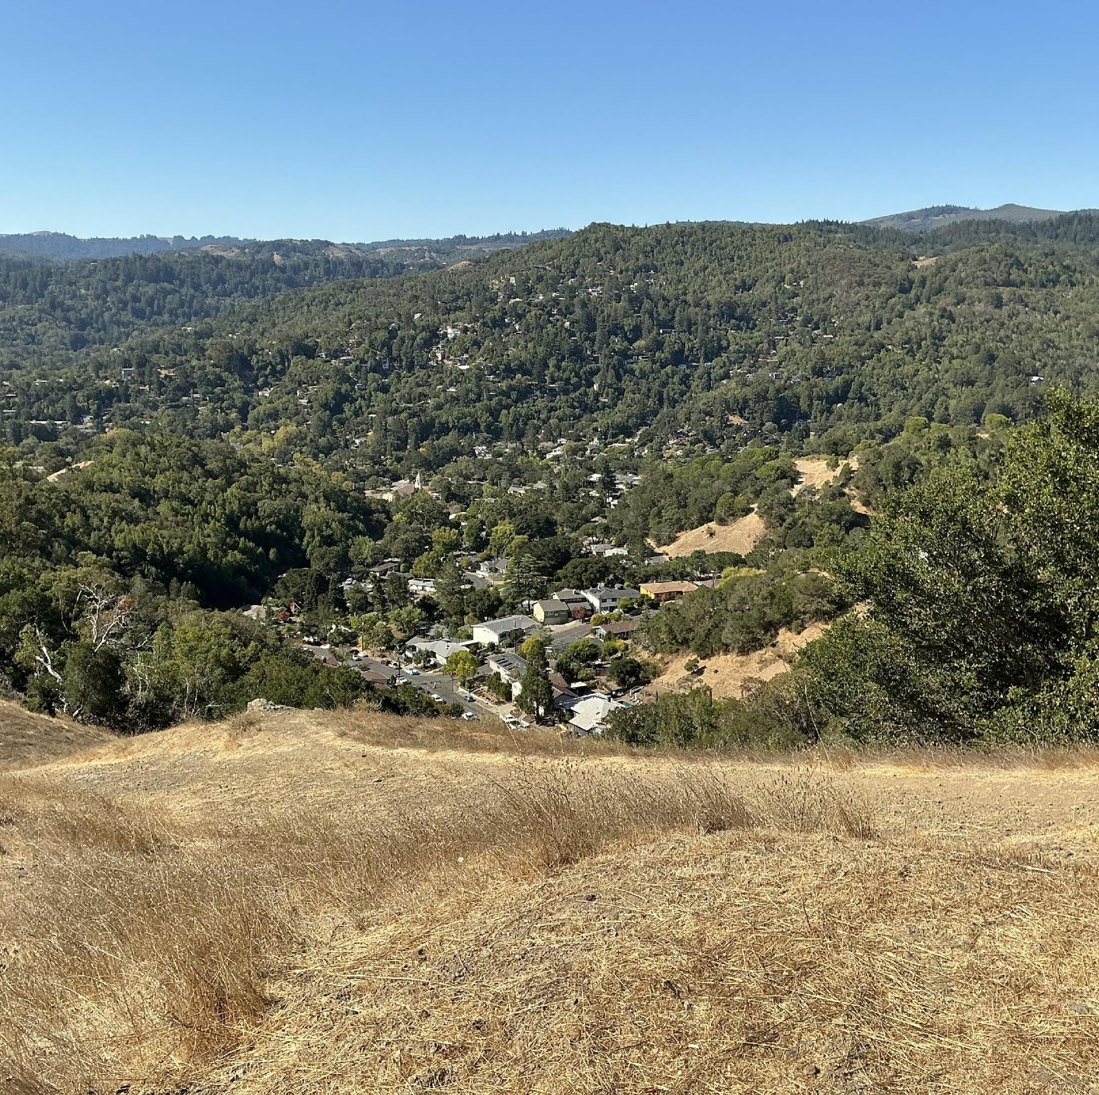
Large Scale Fuel Modification Projects
Typically conducted with neighboring jurisdictions or public works departments
Purpose:
Reduces fuel loads across both private and public properties
Lower neighborhood fire risks
Create safer and more accessible public spaces
Project Scope:
Typically, large-scale open space projects
Completed in partnership with other government agencies
Additional Benefits:
Enhance public access
Support broader community and environmental goals beyond fire risk reduction

Slide 17
Questions?
Thank you!

